Slide 1
Design and Display of Rational B-spline Motion and Global Least Squares Approximation and Interpolation Motion
Team 2
Steven Zilg & Austin Henthorne

Slide 2
Problem Statement
Create Rational B-spline Motions Using:
A given set of spatial displacement control points
Global curve interpolation on a set of spatial displacement data
Global least squares approximation on a set of spatial displacement data

Slide 3
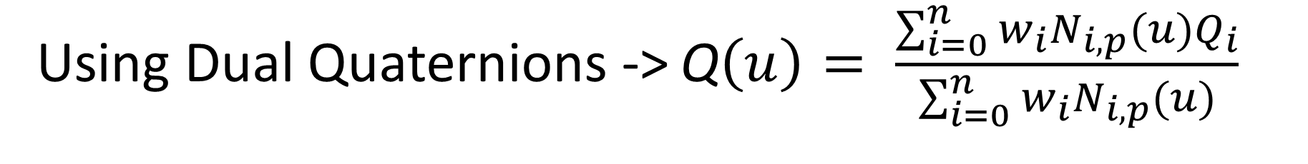
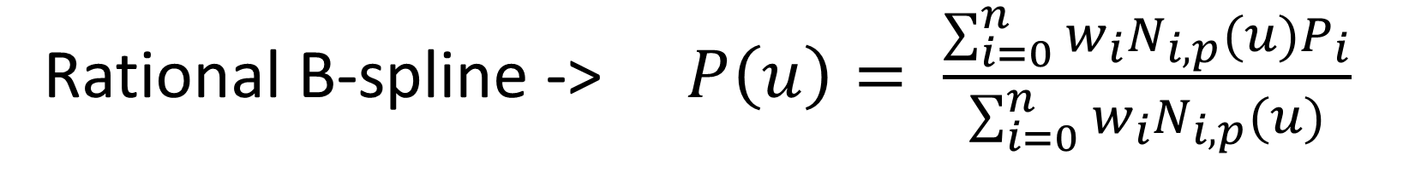
Governing Equation
Rational B-spline -> $P\left(u\right)= \frac{\sum_{i=0}^{n}{w_{i}N_{i,p}(u)P_{i}}}{\sum_{i=0}^{n}{w_{i}}N_{i,p}(u)}$
Using Dual Quaternions -> Q$\left(u\right)= \frac{\sum_{i=0}^{n}{w_{i}N_{i,p}(u)Q_{i}}}{\sum_{i=0}^{n}{w_{i}}N_{i,p}(u)}$
** Set all weights, $w_{i}$, to 1 for this prototype implementation

Slide 4
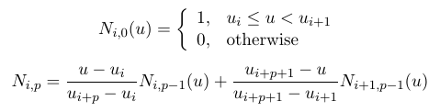
Basis Functions

Slide 5


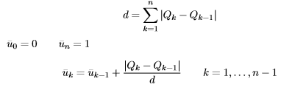

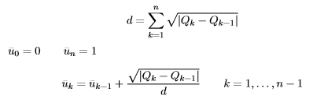
Parameterization Knot Selection
Equally spaced
Chord Length
Centripetal
Equally spaced
Averaging

Slide 6
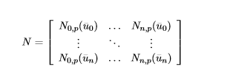

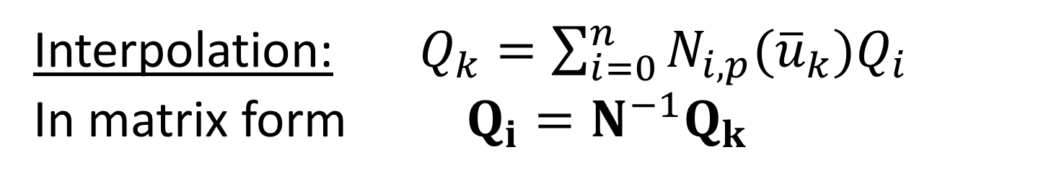
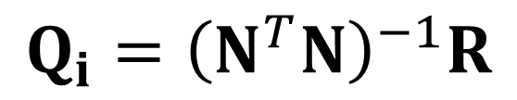
Interpolation: $Q_{k}=\sum_{i=0}^{n}{N_{i,p}({\overline{u}}_{k})Q_{i}}$
In matrix form $Q_{i}=N^{−1}Q_{k}$
Approximation:
$$Q_{i}={\left(N^{T}N\right)}^{−1}R$$

Slide 7
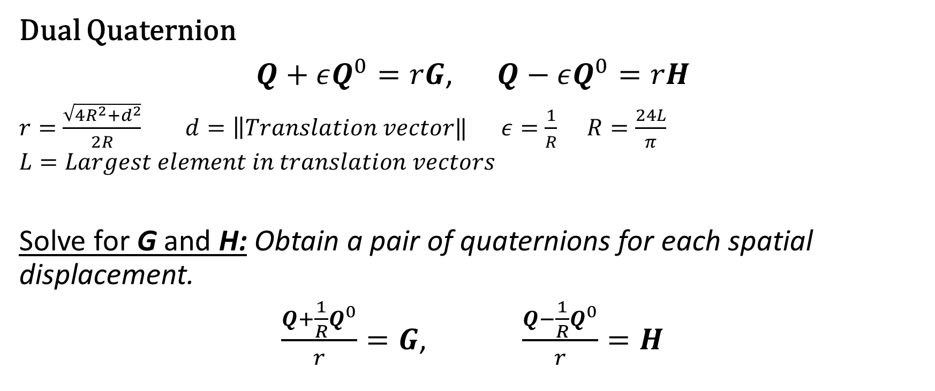
Double Quaternions
Dual Quaternion
$Q+εQ^{0}=rG$, $Q−εQ^{0}=rH$
$r=\frac{\sqrt{4R^{2}+d^{2}}}{2R}$ $d=\left\|Translation vector‖\right.$ $ε=\frac{1}{R}$ $R=\frac{24L}{π}$
$$L=Largest element in translation vectors$$
Solve for G and H: Obtain a pair of quaternions for each spatial displacement.
$\frac{Q+\frac{1}{R}Q^{0}}{r}=G$, $\frac{Q−\frac{1}{R}Q^{0}}{r}=H$
Biquaternion

Slide 8

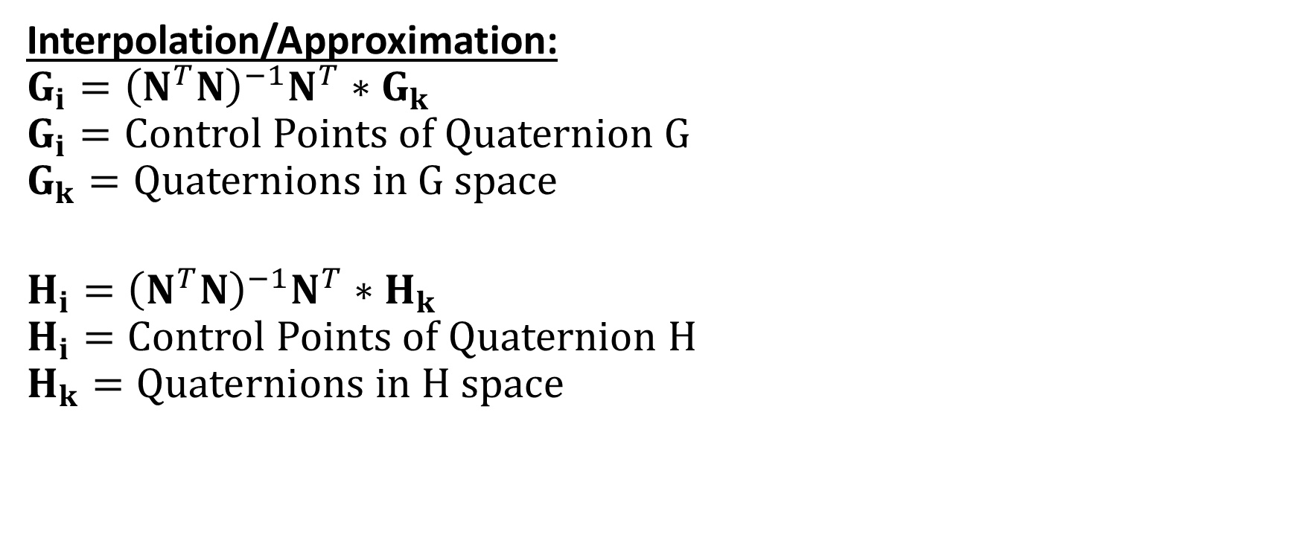


Control Points
Interpolation/Approximation:
$$G_{i}={\left(N^{T}N\right)}^{−1}N^{T}∗G_{k}$$
$$G_{i}=Control Points of Quaternion G$$
$$G_{k}=Quaternions in G space$$
$$H_{i}={\left(N^{T}N\right)}^{−1}N^{T}∗H_{k}$$
$$H_{i}=Control Points of Quaternion H$$
$$H_{k}=Quaternions in H space$$
$$G_{k}=\sum_{i=0}^{n}{N_{i,p}\left({\overline{u}}_{k}\right)G_{i}}$$
$$H_{k}=\sum_{i=0}^{n}{N_{i,p}\left({\overline{u}}_{k}\right)H_{i}}$$
$N_{i,p}\left({\overline{u}}_{k}\right)=\frac{{{\overline{u}}_{k}−\overline{u}}_{i}}{{\overline{u}}_{i+p}−{\overline{u}}_{i}}N_{i,p−1}\left({\overline{u}}_{k}\right)+\frac{{\overline{u}}_{i+p+1}−{\overline{u}}_{k}}{{\overline{u}}_{i+p+1}−{\overline{u}}_{i+1}}N_{i+1,p−1}({\overline{u}}_{k}$)
$$N$$

Slide 9
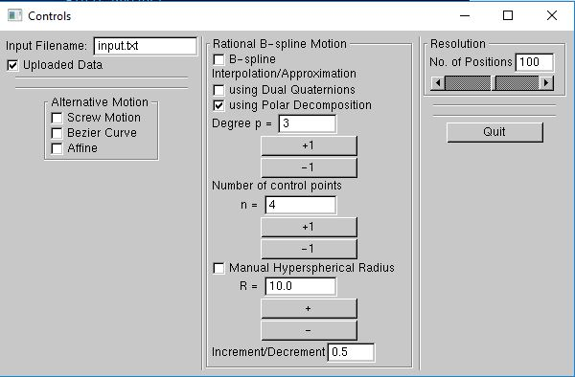
Implementation
File Uploading:
Default file -> “input.txt” comes with software
New files uploaded manually by entering filename
Only .txt files
Must exist in same directory as software executable file
If wrong filename is entered
Error message in console window
“Uploaded data” graphics won’t appear

Slide 10
B-spline Motion
B-spline Motion:
Generates B-spline motion using the input file as control points
No parameterization required
Knot vector ->
clamped, uniform
Users can control degree and resolution

Slide 11

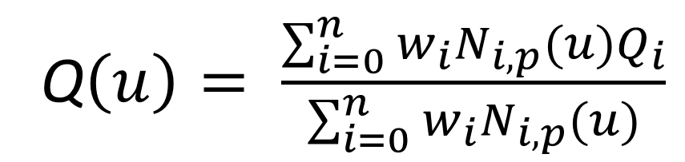
B-spline Motion
Equally spaced parameters
Clamped, equally spaced knot vector
Orientations
Positions
Dual Quaternions
$$Q_{i}$$
Dual Quaternions
𝑄_𝑖
Q$\left(u\right)= \frac{\sum_{i=0}^{n}{w_{i}N_{i,p}(u)Q_{i}}}{\sum_{i=0}^{n}{w_{i}}N_{i,p}(u)}$

Slide 12
Interpolation/Approximation
B-spline Interpolation or Approximation:
Generates B-spline motion using the input file as desired points along the path
Uniform parameterization
Knot vector ->
clamped, uniform
Users can control degree, resolution, number of desired control points, and hyperspherical radius

Slide 13
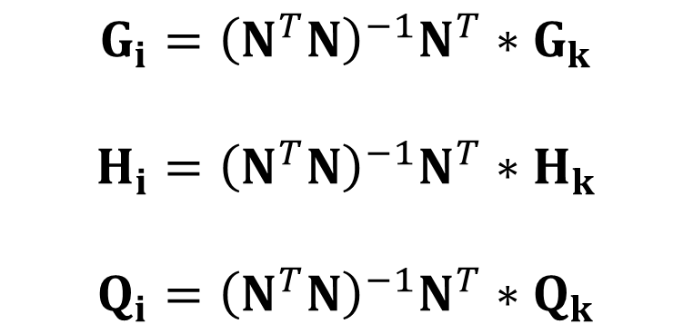
Interpolation/Approximation
Equally spaced parameters
Clamped, equally spaced knot vector
Orientations
Positions
Dual Quaternions
$$Q_{i}$$
Dual Quaternions
𝑄_𝑖
Quaternion
$$G_{k}$$
Quaternion
𝐺_𝑘
Quaternion
$$H_{k}$$
Quaternion
𝐻_𝑘
Dual Quaternions
$$Q_{k}$$
Dual Quaternions
𝑄_𝑘
$$G_{i}={\left(N^{T}N\right)}^{−1}N^{T}∗G_{k}$$
$$H_{i}={\left(N^{T}N\right)}^{−1}N^{T}∗H_{k}$$
$$Q_{i}={\left(N^{T}N\right)}^{−1}N^{T}∗Q_{k}$$

Slide 14
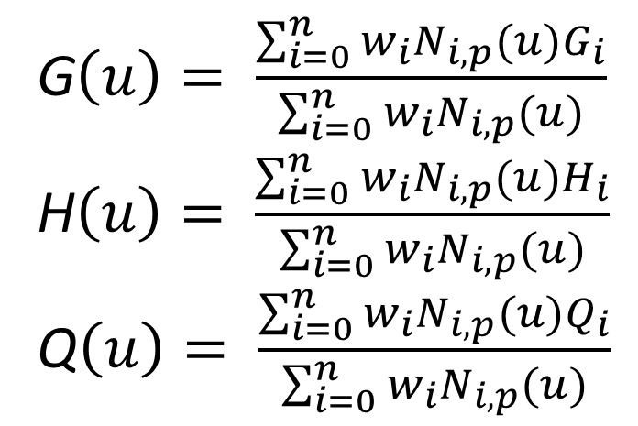
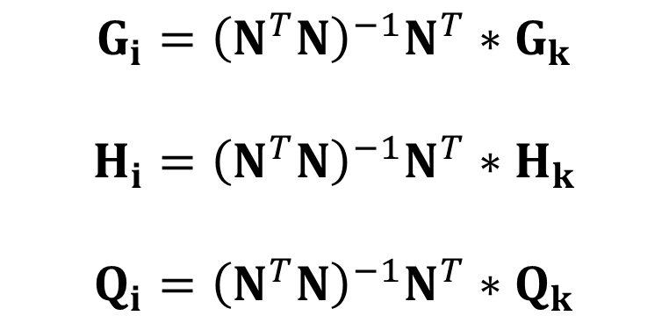
Interpolation/Approximation
Equally spaced parameters
Clamped, equally spaced knot vector
G$\left(u\right)= \frac{\sum_{i=0}^{n}{w_{i}N_{i,p}(u)G_{i}}}{\sum_{i=0}^{n}{w_{i}}N_{i,p}(u)}$
H$\left(u\right)= \frac{\sum_{i=0}^{n}{w_{i}N_{i,p}(u)H_{i}}}{\sum_{i=0}^{n}{w_{i}}N_{i,p}(u)}$
Q$\left(u\right)= \frac{\sum_{i=0}^{n}{w_{i}N_{i,p}(u)Q_{i}}}{\sum_{i=0}^{n}{w_{i}}N_{i,p}(u)}$
$$G_{i}={\left(N^{T}N\right)}^{−1}N^{T}∗G_{k}$$
$$H_{i}={\left(N^{T}N\right)}^{−1}N^{T}∗H_{k}$$
$$Q_{i}={\left(N^{T}N\right)}^{−1}N^{T}∗Q_{k}$$

Slide 15

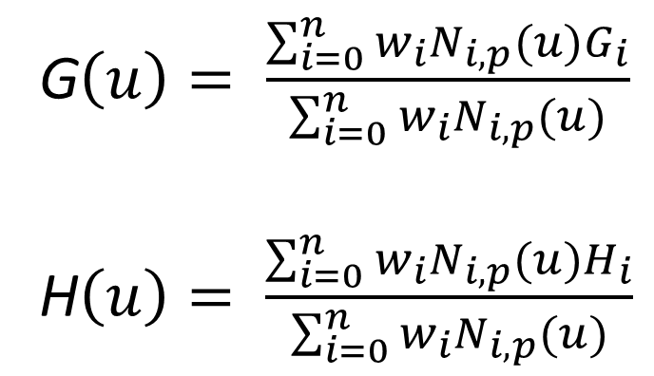
Interpolation/Approximation
G$\left(u\right)= \frac{\sum_{i=0}^{n}{w_{i}N_{i,p}(u)G_{i}}}{\sum_{i=0}^{n}{w_{i}}N_{i,p}(u)}$
H$\left(u\right)= \frac{\sum_{i=0}^{n}{w_{i}N_{i,p}(u)H_{i}}}{\sum_{i=0}^{n}{w_{i}}N_{i,p}(u)}$
$$G+H=DQ+D^{∗}Q=\left(D+D^{∗}\right)Q=2D_{4}Q$$
$$Q=\frac{G+H}{|G+H|}$$
$$D_{4}=\frac{|G+H|}{2}$$
$$r=\frac{1}{D_{4}}$$
$$rG=Q+εQ^{0}=Q+\frac{1}{R}Q^{0}$$
$$Q^{0}=R(rG−Q)$$
$$Q\left(u\right)=\left\{Q,Q^{0}\right\}$$
Quaternion
$$G(u)$$
Quaternion
𝐺(𝑢)
Quaternion
$$H(u)$$
Quaternion
𝐻(𝑢)
Dual Quaternions
$$Q(u)$$
Dual Quaternions
𝑄(𝑢)

Slide 16
Prototype Demo…

